Slide 1


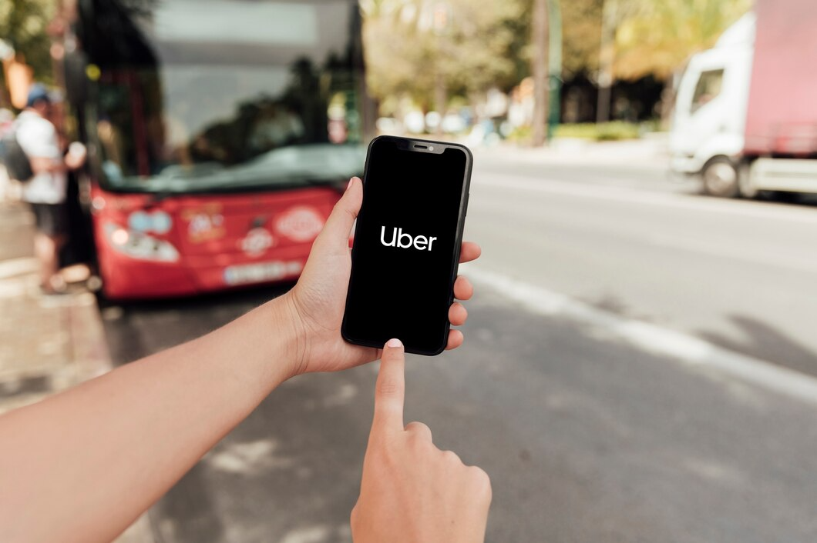


Presentation 2023
UBER DATA
ANALYSIS

Slide 2


Meet the Team
01
Narasimha Daddala
Team Lead & Data Analyst
Navakanth Reddy Bovilla
Data Engineer
02
03
Yash Jagdishbhai Nayi
Data Engineer

Slide 3


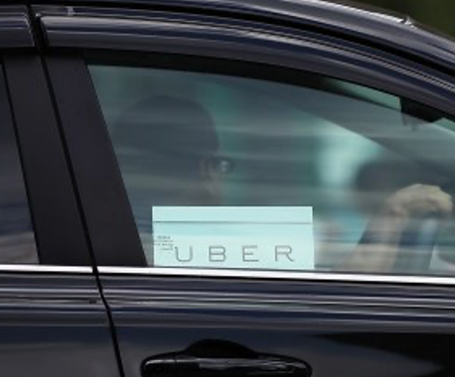


Problem Statement
Problem Statement #1
Problem Statement #2
Problem Statement #3
Uber Is Serving New York’s Outer Boroughs More Than Taxis Are?
Public Transit Should Be Uber’s New Best Friend?
Is Uber Making NYC Rush-Hour Traffic Worse?

Slide 4


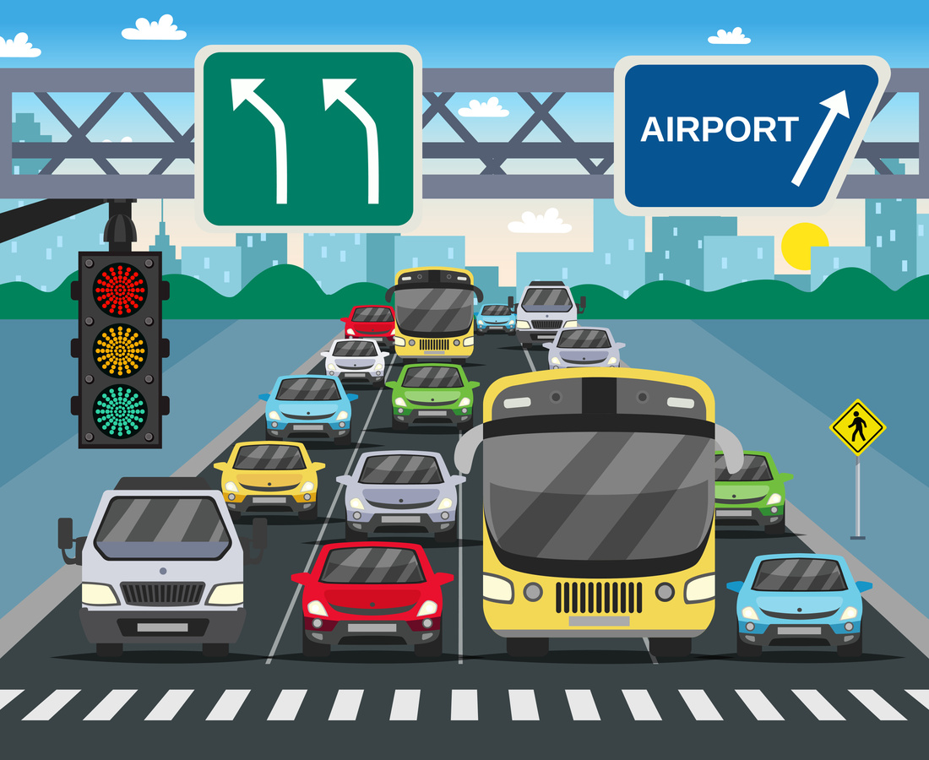

THE SOLUTION
Mode of Transportation
potential synergy between Uber and public transit systems
investigate the impact of Uber on rush-hour traffic
This analysis, would involve looking at the number of rides, location coverage, and the rest of the factors to set the extent of Uber’s presence in the area
exploring how Uber can complement public transportation by providing convenient last-mile solutions, especially in areas with limited transit options. The analysis would focus on strategies for enhancing the cooperation between Uber and public transit for the benefit of commuters.
By studying traffic data, including congestion levels, travel times, and the prevalence of ride-sharing services meanwhile peak hours. To determine

Slide 5





Tips & Rating your driver
Enjoy your ride
Choose ride for User’s location to Targeted destination
Download the application

Slide 6




Business Model
Data Set
Data Set from Kaggle
Deploy
ment
Data Cleaning
Team’s
Plan
Evalution
Feature Extraction
Modeling

Slide 7
Market Size
Yearly active users
130M
2023
101M
2021
93M
2019

Slide 8







Tools Use
Python :
Programming language for building Uber data analysis
Scikit-learn: is an open source machine learning library that supports supervised and unsupervised learning
Jupyter is a project to develop open-source software, open standards, and services for interactive computing across multiple programming languages
TensorFlow library for machine learning and artificial intelligence. It can be used across a range of tasks but has a particular focus on training and inference of deep neural networks.
Pandas: data manipulation and analysis. In particular, it offers data structures and operations for manipulating numerical tables and time series.

Slide 9

Safety to Customers
In-App Safety Features
Insurance
The Uber app includes safety features like real-time GPS tracking, shareable ride details, and a 24/7 emergency button for users to contact authorities in case of an emergency.
Uber provides liability insurance for all rides, which covers both riders and driver-partners in the event of an accident during an Uber trip.
Identity Verification
Rating System
Uber is increasingly implementing identity verification measures to ensure that the driver-partner and the rider are matched with the correct individuals, enhancing safety.
Both riders and drivers can rate each other after a trip, creating accountability and transparency. Low-rated drivers or riders may face consequences.

Slide 10


THANK YOU

